Slide 1
GPU Training RSA Team Day 18th June 2025

Slide 2


Course Philosophy
Complete Pipeline Approach
Leveraging rather than “programming”
Notes:
There is a complete pipeline approach, and so im not going to just jump straight in and start talking about what GPU programming is, instead I am going to talk about all the other building blocks that you need for the GPU stuff to work.
It also takes the approach that we are going to discuss leveraging GPU, rather than just strictly programming GPU. This means we are not going to talk to much in this course about moving data between a CPU and a GPU, but rather abstracting away that component and designing our code in such a way to make the best use of GPUs, and what sort of problems are best suited for GPUs.
The goal of this course is essentially that by the end of the workshop you will have a good understanding of what problems can utilise a GPU and how to actually go about setting everything up to achieve that.

Slide 3


Course Design
Parallel Tracks
Buffet Style Mountain of Content (that you are not expected to cover!)
Notes:
There is no way we could fit in a true GPU course in a single day.
The goal is to signpost to the tools and technologies that are key to you being able to compile and run the code for GPUs. Its not a problem where everyone is going to get everything they need for this
It is also the case that normally for the HPC problems that you will encounter they take a considerable amount of time to run
There is also a considerable spread in the understanding of HPCs, Slurm scripts and many other relevant topics to this day, as such a lot of this will cover some common ground but the hope is that it feels a lot more like a workshop, where me and Stephen will go around and help out rather than deliverying lecture content and following along. You can choose your own path through the content.

Slide 4


Instructor Context
A New Frontier
Assumptions
Notes:
This is very much a new frontier for us in the context of GPUs
Each HPC can be quite different and so please bear with us, alongside we might have assumed some prior knowledge in different locations, if something is confusing please let us know, and as a group we can try and answer it.
My hope is that this will very much be a community effort to upskill everyone in some dimensions and learn something new.

Slide 5
Agenda
Understanding GPUs and CPUs | Spack | Slurm Job Scheduling | Conways Game of Life | Profiling and Optimisation | 3D Temperature Diffusion
Morning Session Traditional Delivery | Morning Session Traditional Delivery | Morning Session Traditional Delivery | Afternoon Session Project Workshop Delivery | Afternoon Session Project Workshop Delivery | Afternoon Session Project Workshop Delivery
Notes:
The intention is for the first three sessions to be from 1000-1230 and then for the afternoon to be from 1330-1630 until the end of the day

Slide 6

Notes:
Trying to work out what you don’t know, and then recognising that it is helpful down the road

Slide 7

The Future of HPC
Notes:
There is a very real change that this course does not prepare you for the future of HPC.
It seems like GPUs themselves might be going out of fashion, with new developments such as Grace-Hopper Superchip.
As we will see, currently the main thing you want to minimise is data movement to the VRAM for the GPU, but with Grace-Hopper chips all of that overhead is eliminated due to the chip design.
It is also very much up for debate what the future of this sort of programming will look like, with a lot of different tools being proposed and tested. Personally agree with someone Michael mentioned a while back and that the compiler will eventually be smart enough to work it out for us, but with what level of annotation will be.
This is why this course is focused more on general understanding of GPUs and why to use them, rather than the nuances of actual programming them as it might turn out you never need to!

Slide 8
Understanding GPUs and CPUs

Slide 9

What is a GPU?
Notes:
GPUs stand for Graphics Processing Unit. Historically they were specialised processors designed to handle graphics rendering, the ones that are now being produced are a lot more general purpose computing

Slide 10
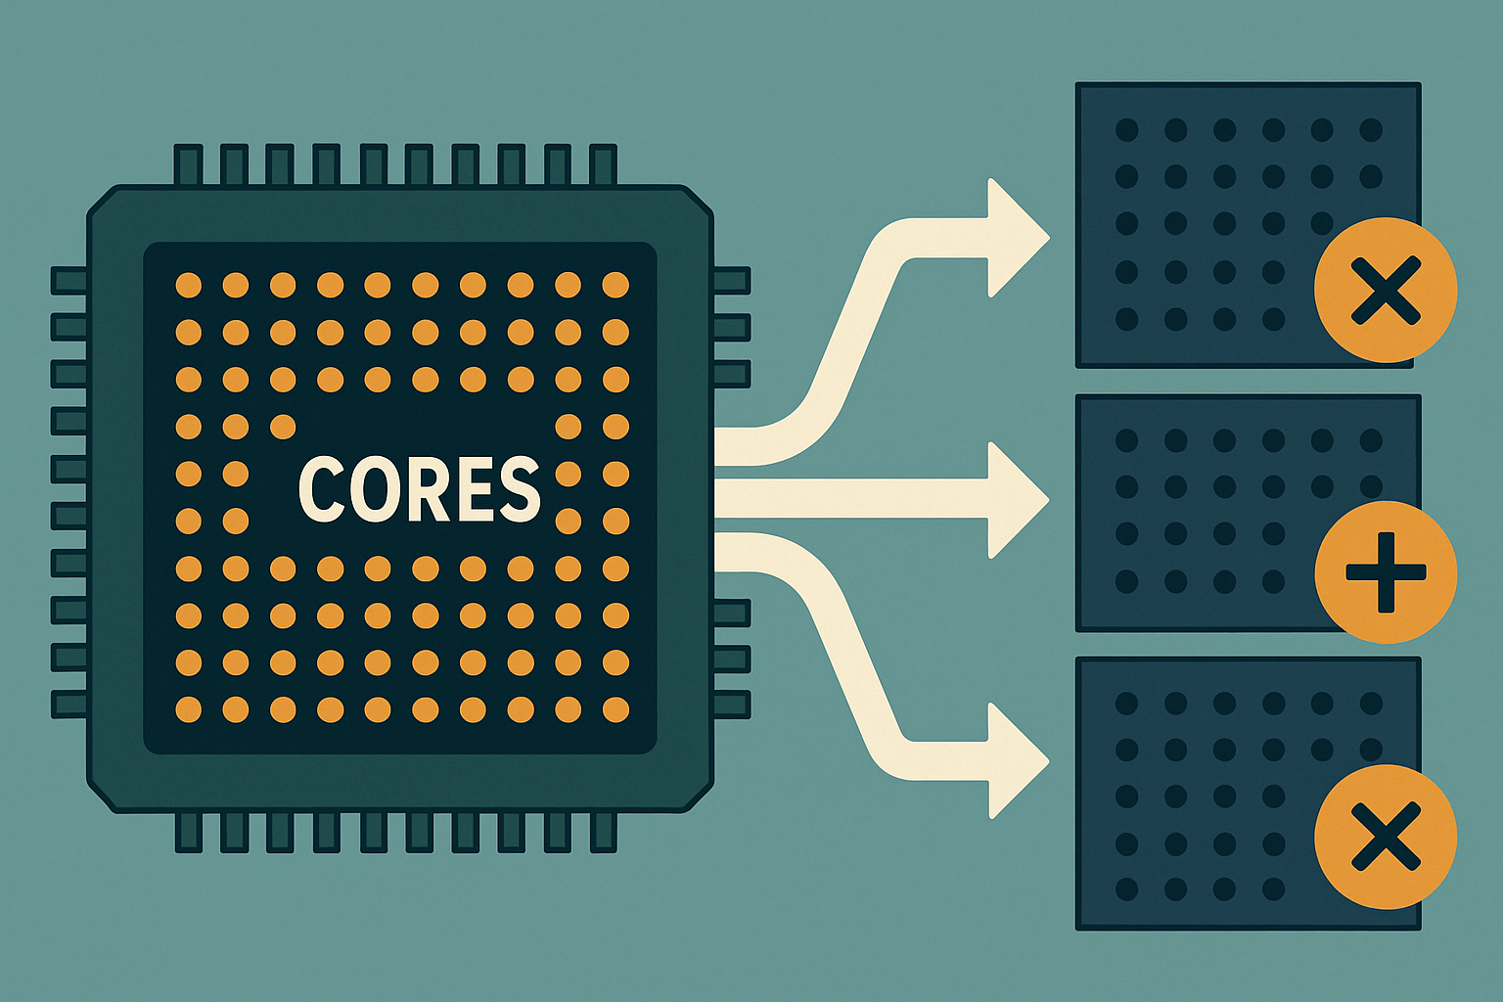
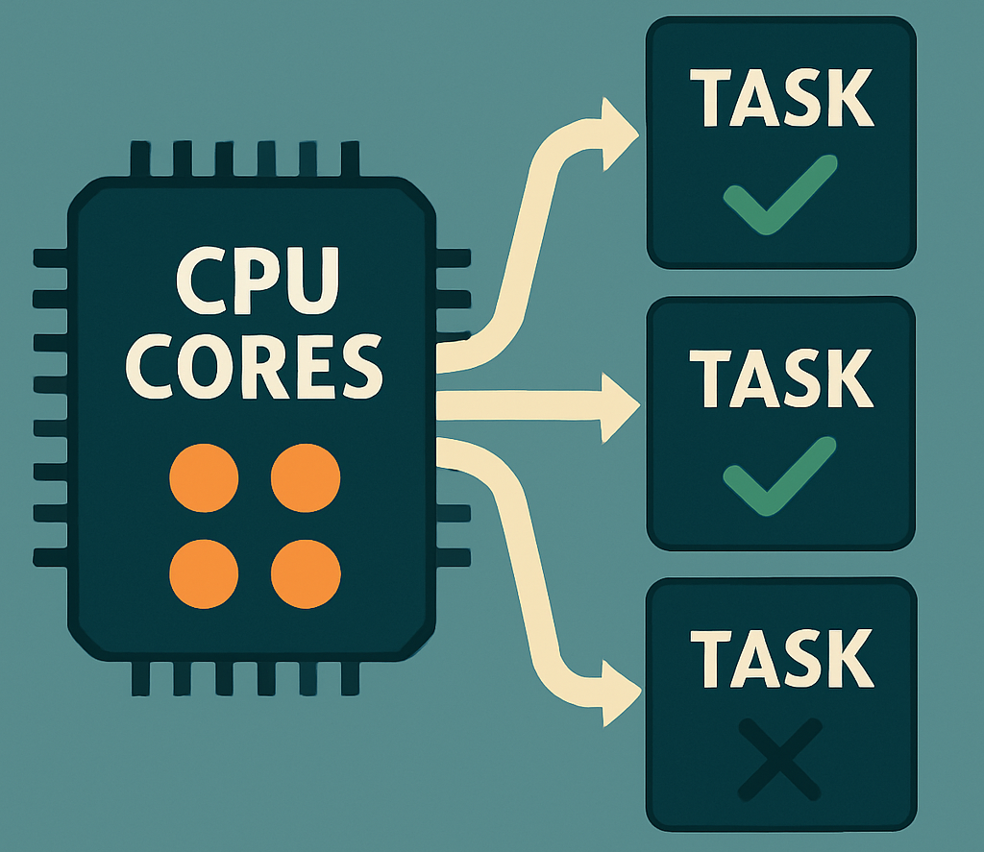
Key Characteristics of a GPU Many Cores
GPU
CPU
GPUs shine when you can split your problem into lots of identical, independent pieces and process them simultaneously.
CPUs excel at fewer, diverse tasks where each thread may follow its own, unpredictable path through the code.
Notes:
A GPU contains hundreds or thousands of small cres, also known as processing units. For example, an NVIDIA CUDA-enabled GPU can have thousands of threads running in parallel, which is great for tasks that are running the same operation on many data points at the same time. I generally think of this in terms of image processing, e.g. applying a filter to an image.
A CPU is very good at branch heavy code (e.g. if statements), complex control flow, and general purpose computing.
GPUs shine when you can split your problem into lots of identical, independent pieces and process them simultaneously.
CPUs excel at fewer, diverse tasks where each thread may follow its own, unpredictable path through the code.

Slide 11
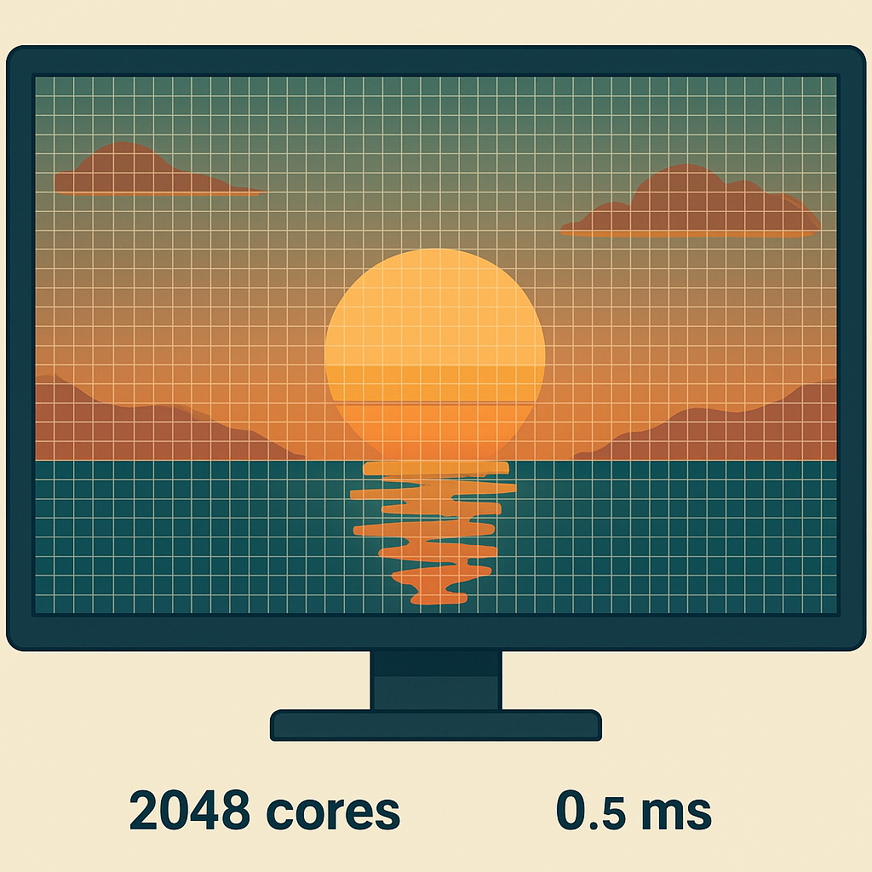

Key Characteristics of a GPU Highly Throughput-Oriented
Let’s say we have a single 4K frame, which is 3840x2160 pixels, which is 8.29 million pixels.
Say a pixel operation takes:
CPU: 0.05µs
GPU: 0.20µs
Serial Time:
CPU: 8.29M * 0.05µs = 0.415s
GPU: 8.29M * 0.20µs = 1.66s
However
A CPU has 4 cores, and a GPU has 2048 cores
Parallel Time:
CPU: 0.415s / 4 ~ 0.1s
GPU: 1.66s / 2048 ~ 0.00081s
Output
CPU: 10 frames per second
GPU: 1233 frames per second
GPU: 2048 Regions
CPU: 4 Regions
Notes:
For a note, the RTX Pro 6000 Blackwell GPU has 24,064 CUDA cores, it is also worth noting that an application that runs on a GPU, is quite trival (from my understanding) to extend to multi GPU since they have to be separate problems that can be split up already.

Slide 12



FLOP = FLoating-Point OPeration
Definition of FLOP
One floating-point arithmetic operations
A single unit of work in scientific/ML code
Throughput
FLOPS = FLOPs per second
1 GFLOP/s = 10^9 FLOPS per second
1 TFLOP/s = 10^12 FLOPs per second
Notes:
The FLOPs are relevant as they measure the raw compute horsepower of the hardware that is being discussed. A GPU will generally be GFLOPS and a GPU will generally hit TFLOPS

Slide 13
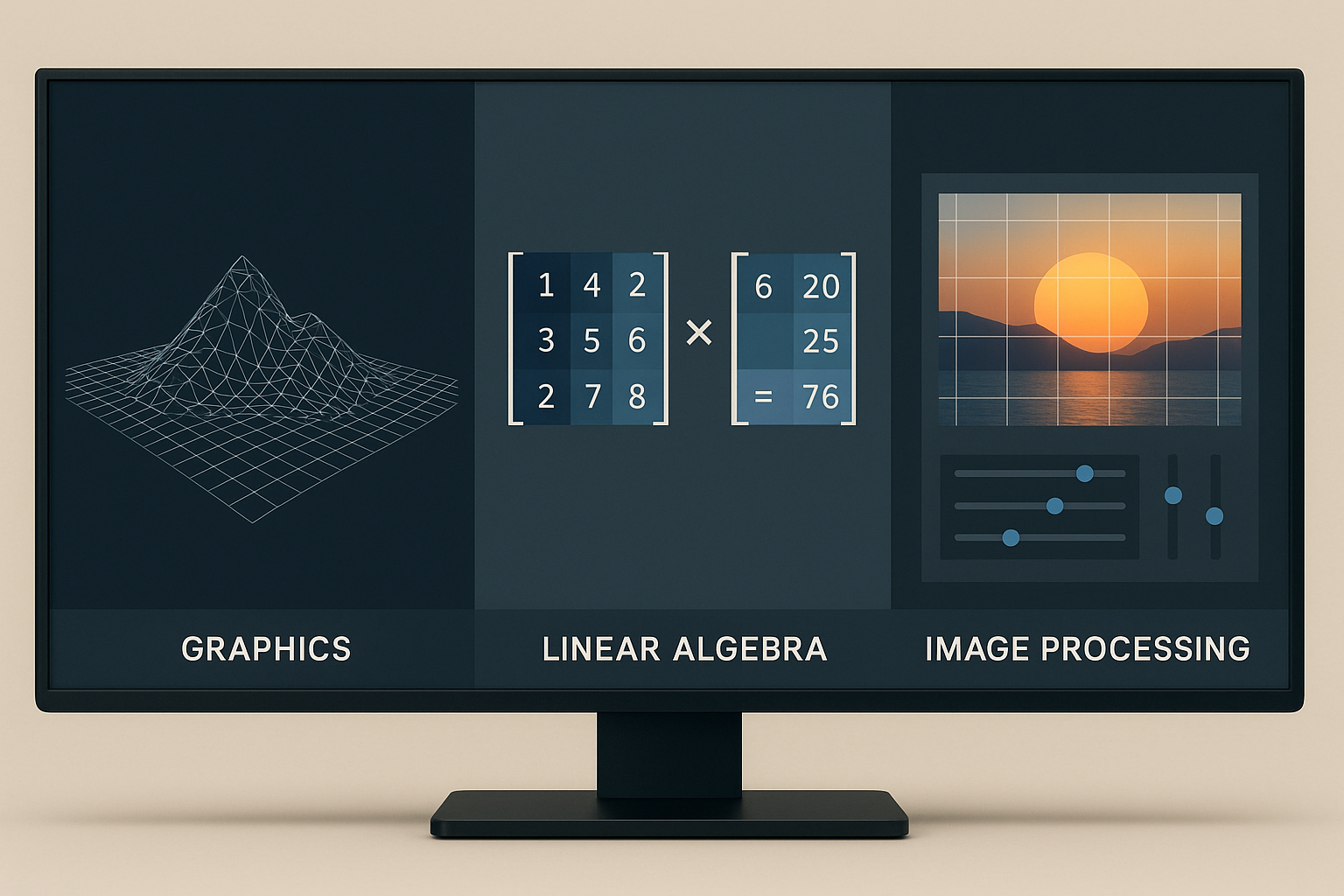
Key Characteristics of a GPU Use Cases
Notes:
The key takeaway being that you can leverage a GPU where you can break a task into many independent pieces, a GPU can often compute all those pieces faster than a CPU by doing them at the same time.

Slide 14
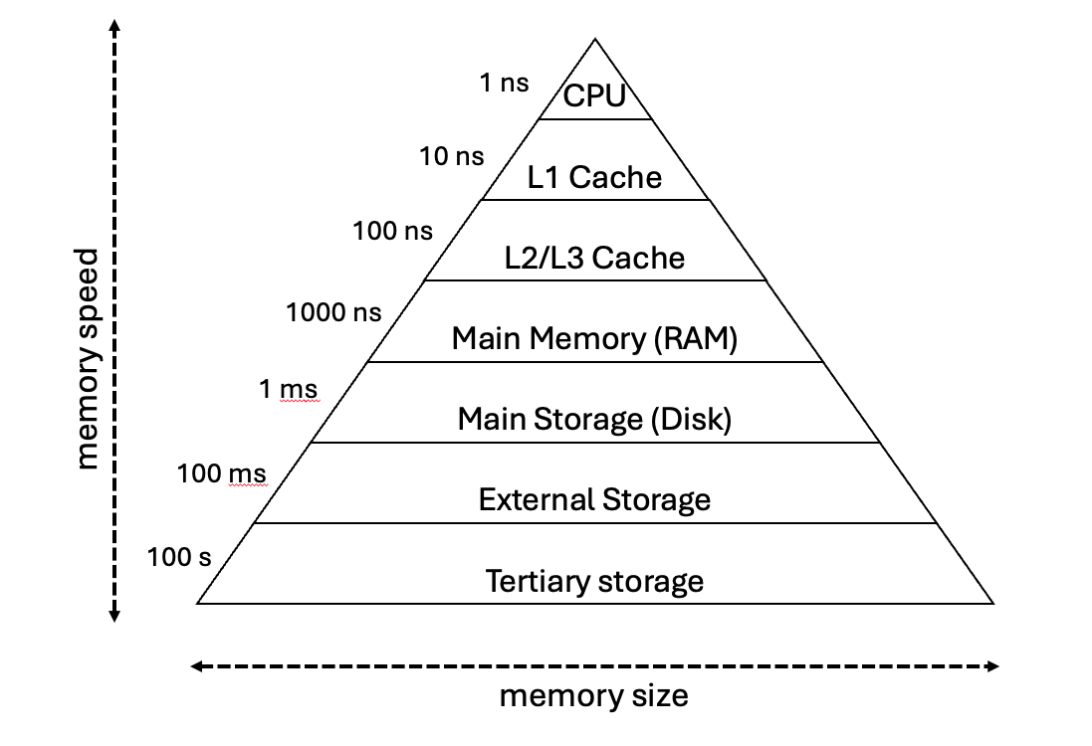
Key Characteristics of a GPU Memory Architecture - CPU
Graphic from CfRR Parallel Computing
Notes:
Within a CPU have a number of different types of memory, such as:
CPU Registers, that have a few bytes to a few KB of memory and are used for immediate operands, instruction pointers
L1 cache, which is tends of KB and holds the hottest data/instructions for a CPU core
L2/L3 cache, which holds hundreds of KB to several MD, and uses a shared or per-core buffers to reduce main memory access
RAM, holds GBs, and has working data, OS structures accessed on cache misses
Disk, TBs, File System, virtual memory backing store
External Storage Tens of TBs, e.g. network attached, USB drives
Tertiary Petabytes (e.g. tape libraries, and used for deep archives and cold storage
There is also always a trade off between the Speed, and Capacity and cost, and the hierarchical element, with caches masks the slow lower level. The goal is that you want to maximise hit rate in fast tiers and minimise expensive accesses

Slide 15

Key Characteristics of a GPU Memory Architecture - CPU

Slide 16
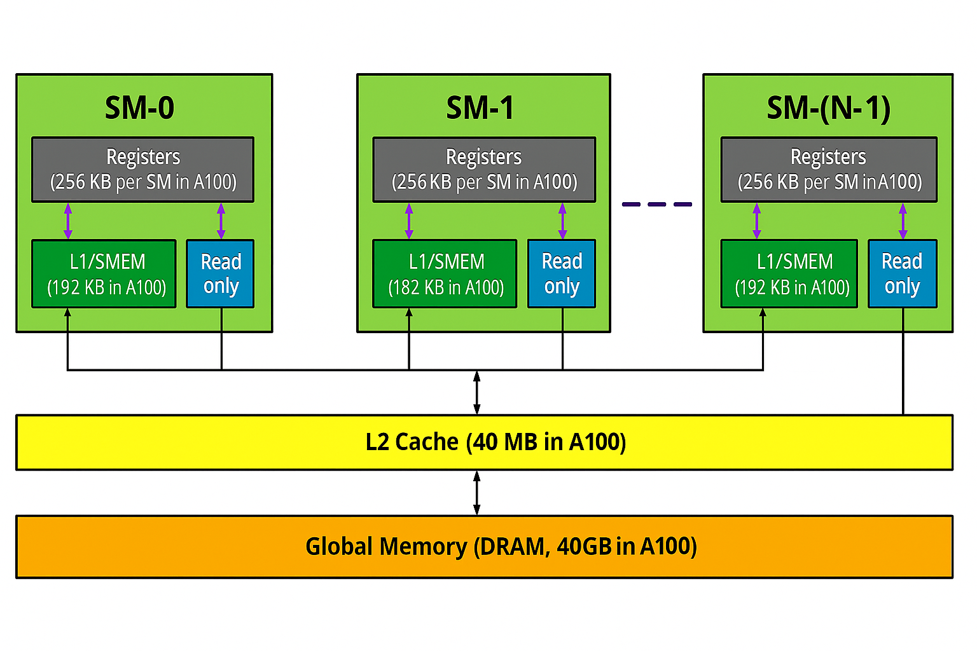
Key Characteristics of a GPU Memory Architecture - GPU
https://www.arccompute.io/arc-blog/gpu-101-memory-hierarchy
Notes:
SM stands for Streaming Multiprocessor, which is a GPU core.
One thing to memtion is that you still have to deal with the previous hierarchy but you now also need to move data to the GPU itself, and then contend with this memory hierarchy.
It also seems there is no agreed upon time for this memory, as it changes so often, so the comparison is based on cycles.
The overview is:
Register: These take 1-2 cycles, and are private per threads, and hold intermediate values and loop indices.
Shared Memory / L1 cache, these takes 2-20 cycles, Very high bandwidth when bank conflicts are minimised, and are on the SM core itself
L2 cache, 50-200 cycles Unified hardware managed across all the SMs
Global Device Memory – VRAM with 200-800 cycles. This is the main working set for kernels
Host Memory (PCIe / NVLink), Transfers between GPU VRAM and system RAM You want to overlap transfers with compute, and set up where you have enough data to do compute

Slide 17



Example: Tiny Batch Matrix-Vector Multiplication
Problem: You need to multiply 100,000 independent 16x16 matrices against 16-element vectors, a common problem in batched ML inferences
Current Approach: CPU has no memory movement costs (already in RAM), and would take 62 ms of compute
Based on the compute power of a RTX 2080 (10 TFLOP) , and Intel Core i7-9700K (200 GFLOP)
Data Transfer (~6ms)
Kernel Launch (~1ms),
Present but will generally remain constant
Compute (~5ms)
Notes:
You are generally comparing the CPUs raw compute with the GPU data movement costs + kernel launch + compute time.
The two numbers that you can influence and make a decision on are the data transfer time and the compute, but new developments such as Grace-Hopper Chips remove the data transfer time completely.
You also have the issue of will the problem that you want to work on even fit on the VRAM, as it is doesn’t it can make the code that solves the problem considerably harder, and you might want to just
GPU
Each 16x16 matrix + vector ~ 1 KB of data
100,000 of them is equal to ~100MB of data
Transfer overhead (PCIe-4 ~ 16GB/s transfer rate), takes ~6ms
Kernel launch overhead + GPU setup ~1ms
Compute time ~ 5ms (Can be worked out based on FLOPs!)
So the GPU takes 6ms + 5ms + 1ms = 12ms
The kernel launch will be amortized and will remain constant between problems.

Slide 18


Pitfalls and Considerations
Data Transfer Overhead
Parallel Overhead
Precision and Hardware Constraints
Notes:
Data Transfer Overhead: Moving data between CPU (host) memory and GPU (device) memory takes time. For smaller tasks, this overhead can outweigh the GPU’s speed advantage.
Parallel Overhead: Launching kernel (GPU functions) has overhead. If you launch millions of very tiny GPU tasks, the overhead may become significant.
Precision and Hardware Constraints: Some GPUs (especially older ones) might be less predictive for double-precision arithmetic than CPUs or might not support certain features.

Slide 19
Summary: How is a GPU different from a CPU?
Feature | CPU (Central Processing Unit) | GPU (Graphics Processing Unit)
Cores | Few (4–16 desktop; up to a few dozen server) | Hundreds → thousands of “small” cores
Core Power | Each core is very powerful at single-thread work | Each core is simpler; optimized for arithmetic throughput
Parallelism | Excels at sequential or lightly-parallel tasks | Excels at massively-parallel tasks (SIMD/SIMT)
Use-Cases | OS, I/O, database, branching logic, general apps | 3D rendering, ML training/inference, simulations
Memory Access | Direct access to system RAM, big caches (L1–L3) | Accesses its own high-bandwidth VRAM; smaller caches
Latency vs Throughput | Low-latency task switching; moderate FLOP/s | Higher launch/transfer latency; huge FLOP/s throughput

Slide 20

Summary: How is a GPU different from a CPU?
Notes:
If you have a task that requires intricate steps and must be done by one person, the craftsman (CPU) will do it efficiently.
Suppose you have a task that can be broken into 1000 simple, identical steps (like assembling simple parts). In that Case, a factory with 1000 workers (GPU cores) will do all those in parallel much faster than the single craftsman could, even if each worker is not as individually skilled as the craftsman.

Slide 21
Exercise: Group Discussion and Quiz
Notes:
Do you think this is relevant to any of your projects? is there anything you are unclear of and could do with help with, there is also the quiz on the website itself for you to answer
It is also worth noting that there is a question on Compilers that might be confusing and we have not discussed today and so don’t worry if you don’t understand that question!
It is also worth noting that on the website there is some additional content on compilers that you may wish to read. I felt it didn’t fit with the content in the slides aswell as I would have hoped as not everyone will need to understand that, but its worth having there.

Slide 22
HPC Set Up and Login

Slide 23
Logging into ISCA
Notes:
Provide a demo of how to log into ISCA itself when using VSCode

Slide 24
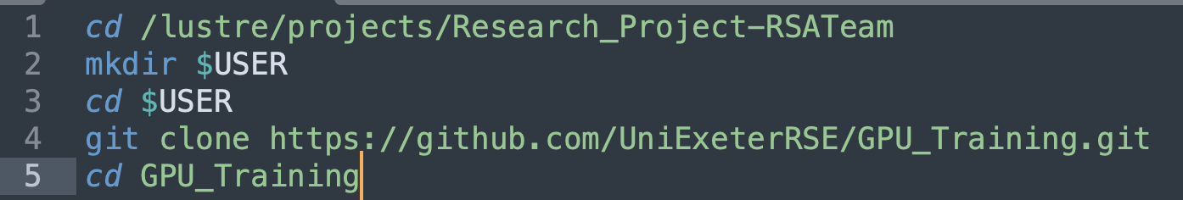
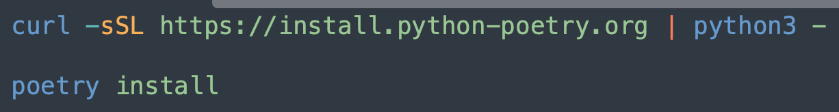
Navigating to our project space
Notes:
Provide a demo of how to log into ISCA itself when using VSCode

Slide 25
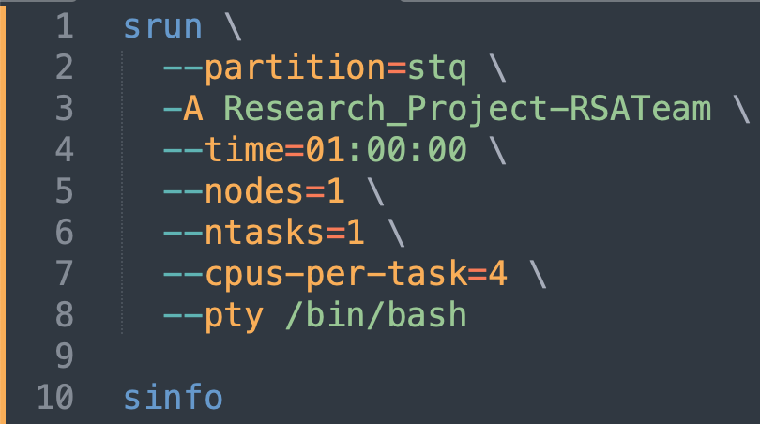
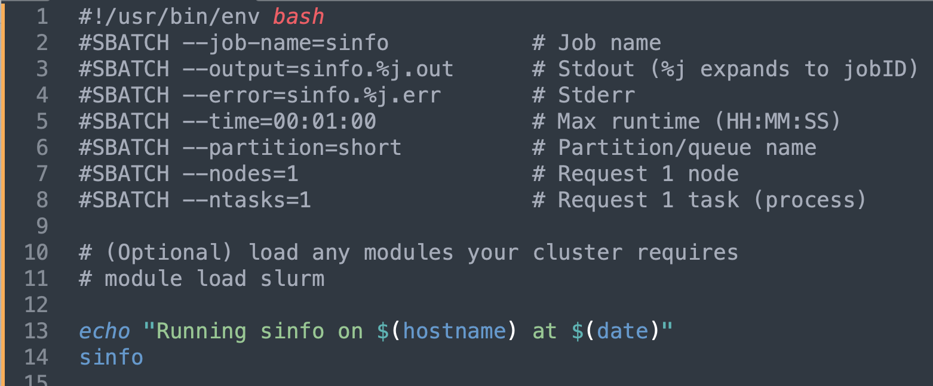

How to run the code Interactive vs Batch
Interactive Mode (Terminal)
Create a .slurm script
Then run
Notes:
Give an overview of the different ways that you can run the code, e.g. with either the srun or the sbatch

Slide 26
Spack

Slide 27
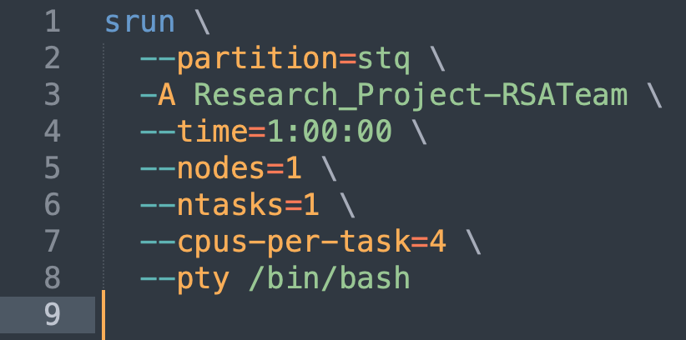
Exploring Spack with an Interactive Mode
Notes:
Give an overview of the different ways that you can run the code, e.g. wit

Slide 28
Getting the right version
Notes:
I find the development of Spack to be quite confusing and don’t totally understand why things are done the way they are

Slide 29
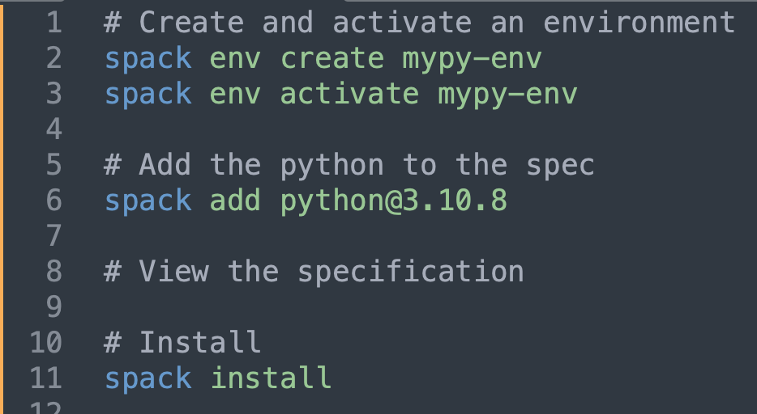
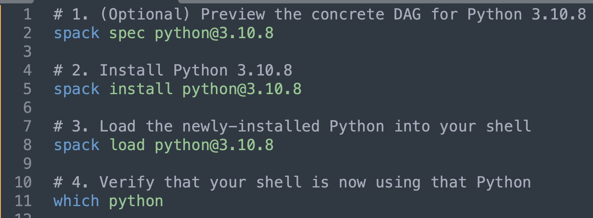
To use environments or not
Environments
More traditional module approach

Slide 30
Exercise: Take the time to try and install a package relevant to you
Spack Commands
Spack Syntax Symbols
Command | Description
spack list <query> | List available packages matching <query> (or all if no query).
spack info <package> | Show package details: versions, variants, dependencies.
spack add <package> | Add a package to the current environment (does not install).
spack remove <package> | Remove a package from the current environment spec.
spack spec | Show the full dependency graph (spec) for the environment.
spack install | Install the environment’s spec (download and build everything needed).
spack find | List installed packages (in current env or globally).
spack load <package> | Load an installed package into the shell.
spack unload <package> | Unload a package from the environment variables.
spack env activate <env> | Activate a named environment (use -p for package view).
spack env deactivate | Deactivate the current environment.
Symbol | Meaning | Example
pkg@X.Y.Z | Version “@” pins the package version. | python@3.10.8
+foo | Enable variant “foo”. | mpich+debug
~bar | Disable variant “bar”. | mpich~hydra
^baz | Dependency on package “baz” (and its version/spec). | hdf5 ^mpi
%gcc@9.4.0 | Compiler directive “%” selects which compiler (and version) to use. | ...%clang@14.0.0
arch=… | Architecture indicates OS, CPU, and ABI details. | arch=linux-ubuntu20.04-x86_64

Slide 31
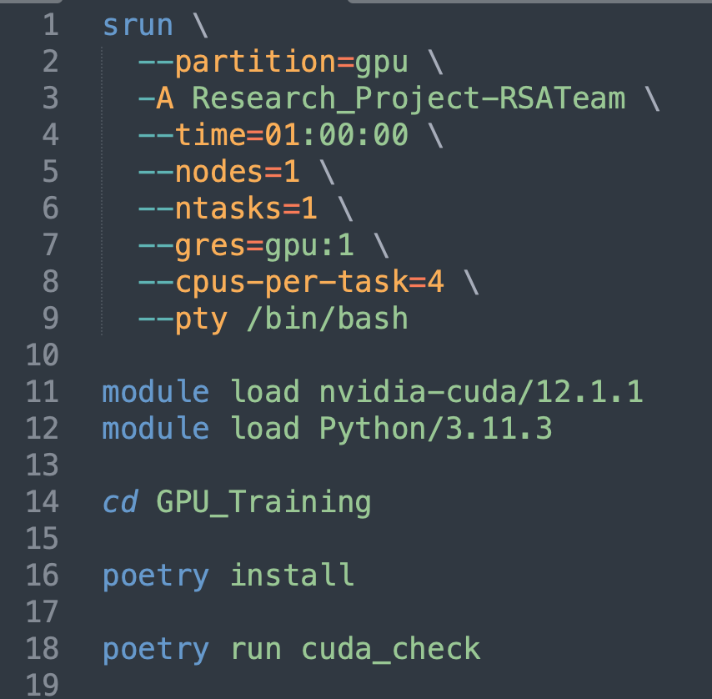
All the software we need is available on ISCA
Notes:
You may also need to install poetry that can be done with: `curl -sSL https://install.python-poetry.org | python3 -

Slide 32
Slurm Job Scheduling

Slide 33

Simple Linux Utility for Resource Management (SLURM)
Open-Source Job Scheduler
Allocated Resources and Schedules Jobs
Notes:
Provide a demo of how to log into ISCA itself when using VSCode

Slide 34
Basic SLURM Workflow
Interactive job:
Use srun to request an interactive session
Wil be dropped into session when available (can request an email when ready)
Use as required
Job submission
Write script to run required program, including module load statements
Add SBATCH directives to the script
Submit the script to the job queue with sbatch, getting back a job ID
Check status of job with squeue
Standard output and standard error will be written to files.
Notes:
Provide a demo of how to log into ISCA itself when using VSCode

Slide 35
Slurm commands and directives
Spack Syntax Symbols
Slurm Commands
Command Line | Env. Variable | Example
-A, --account=<acct> | SBATCH_ACCOUNT | #SBATCH -A Research_Project-RSATeam
-t,--time | SBATCH_TIMELIMIT | #SBATCH –t=0:10:00
-N, --nodes -n, --ntasks --cpus_per_task |  | #SBATCH --nodes=1 #SBATCH --ntasks=4 #SBATCH --cpus_per_task=4
-p, --partition --qos | SBATCH_PARTITION SBATCH_QOS | #SBATCH --partition=short
-a, --array=<indexes> | SBATCH_ARRAY_INX | #SBATCH --array=0,15
--mail-type=<type> --mail-user=<email> |  | #SBATCH --mail-type=END,FAIL #SBATCH –mail-user=me@ex.ac.uk
Command | Description
sbatch | Submit a job script for later execution, which typically contains srun commands. Returns a job ID for use with other commands
srun | Submit a job for execution in real time. We used this above for launching interactive sessions.
squeue | Report the state of jobs. Can filter and sort, e.g. `--user=$USER`
scancel | Cancel a pending or running job
sattach | Attach standard input, output and error to a currently running job.
sinfo | Show state of jobs on partitions and nodes.
Command-Line > Environmental Variables > Script Options
There are a number of output environment variables that can be used in the submission script, e.g. SLURM_JOB_NAME, SLURM_ARRAY_TASK_ID and SLURM_JOB_START_TIME.

Slide 36
Recap: Interactive vs Batch
Interactive Mode (Terminal)
Create a .slurm script
Then run
Notes:
Give an overview of the different ways that you can run the code, e.g. with either the srun or the sbatch

Slide 37
Conways Game of Life

Slide 38

What is Conway's Game of Life?
50 Timesteps on a 100x100 grid
You have a grid of cells, that live or die based on a few rules:
Each cell can be “alive” (1) or “dead” (0).
At each time step (generation), the following rules apply to every cell simultaneously, based on the 8 surrounding neighbours:
Any live cell with fewer than 2 live neighbours dies (underpopulation).
Any live cell with 2 or 3 live neighbours lives on to the next generation (survival).
Any live cell with more than 3 live neighbours dies (overpopulation).
Any dead cell with exactly 3 live neighbours becomes a live cell (reproduction).
Wikipedia | Conway's Game of Life | Examples of patterns

Slide 39
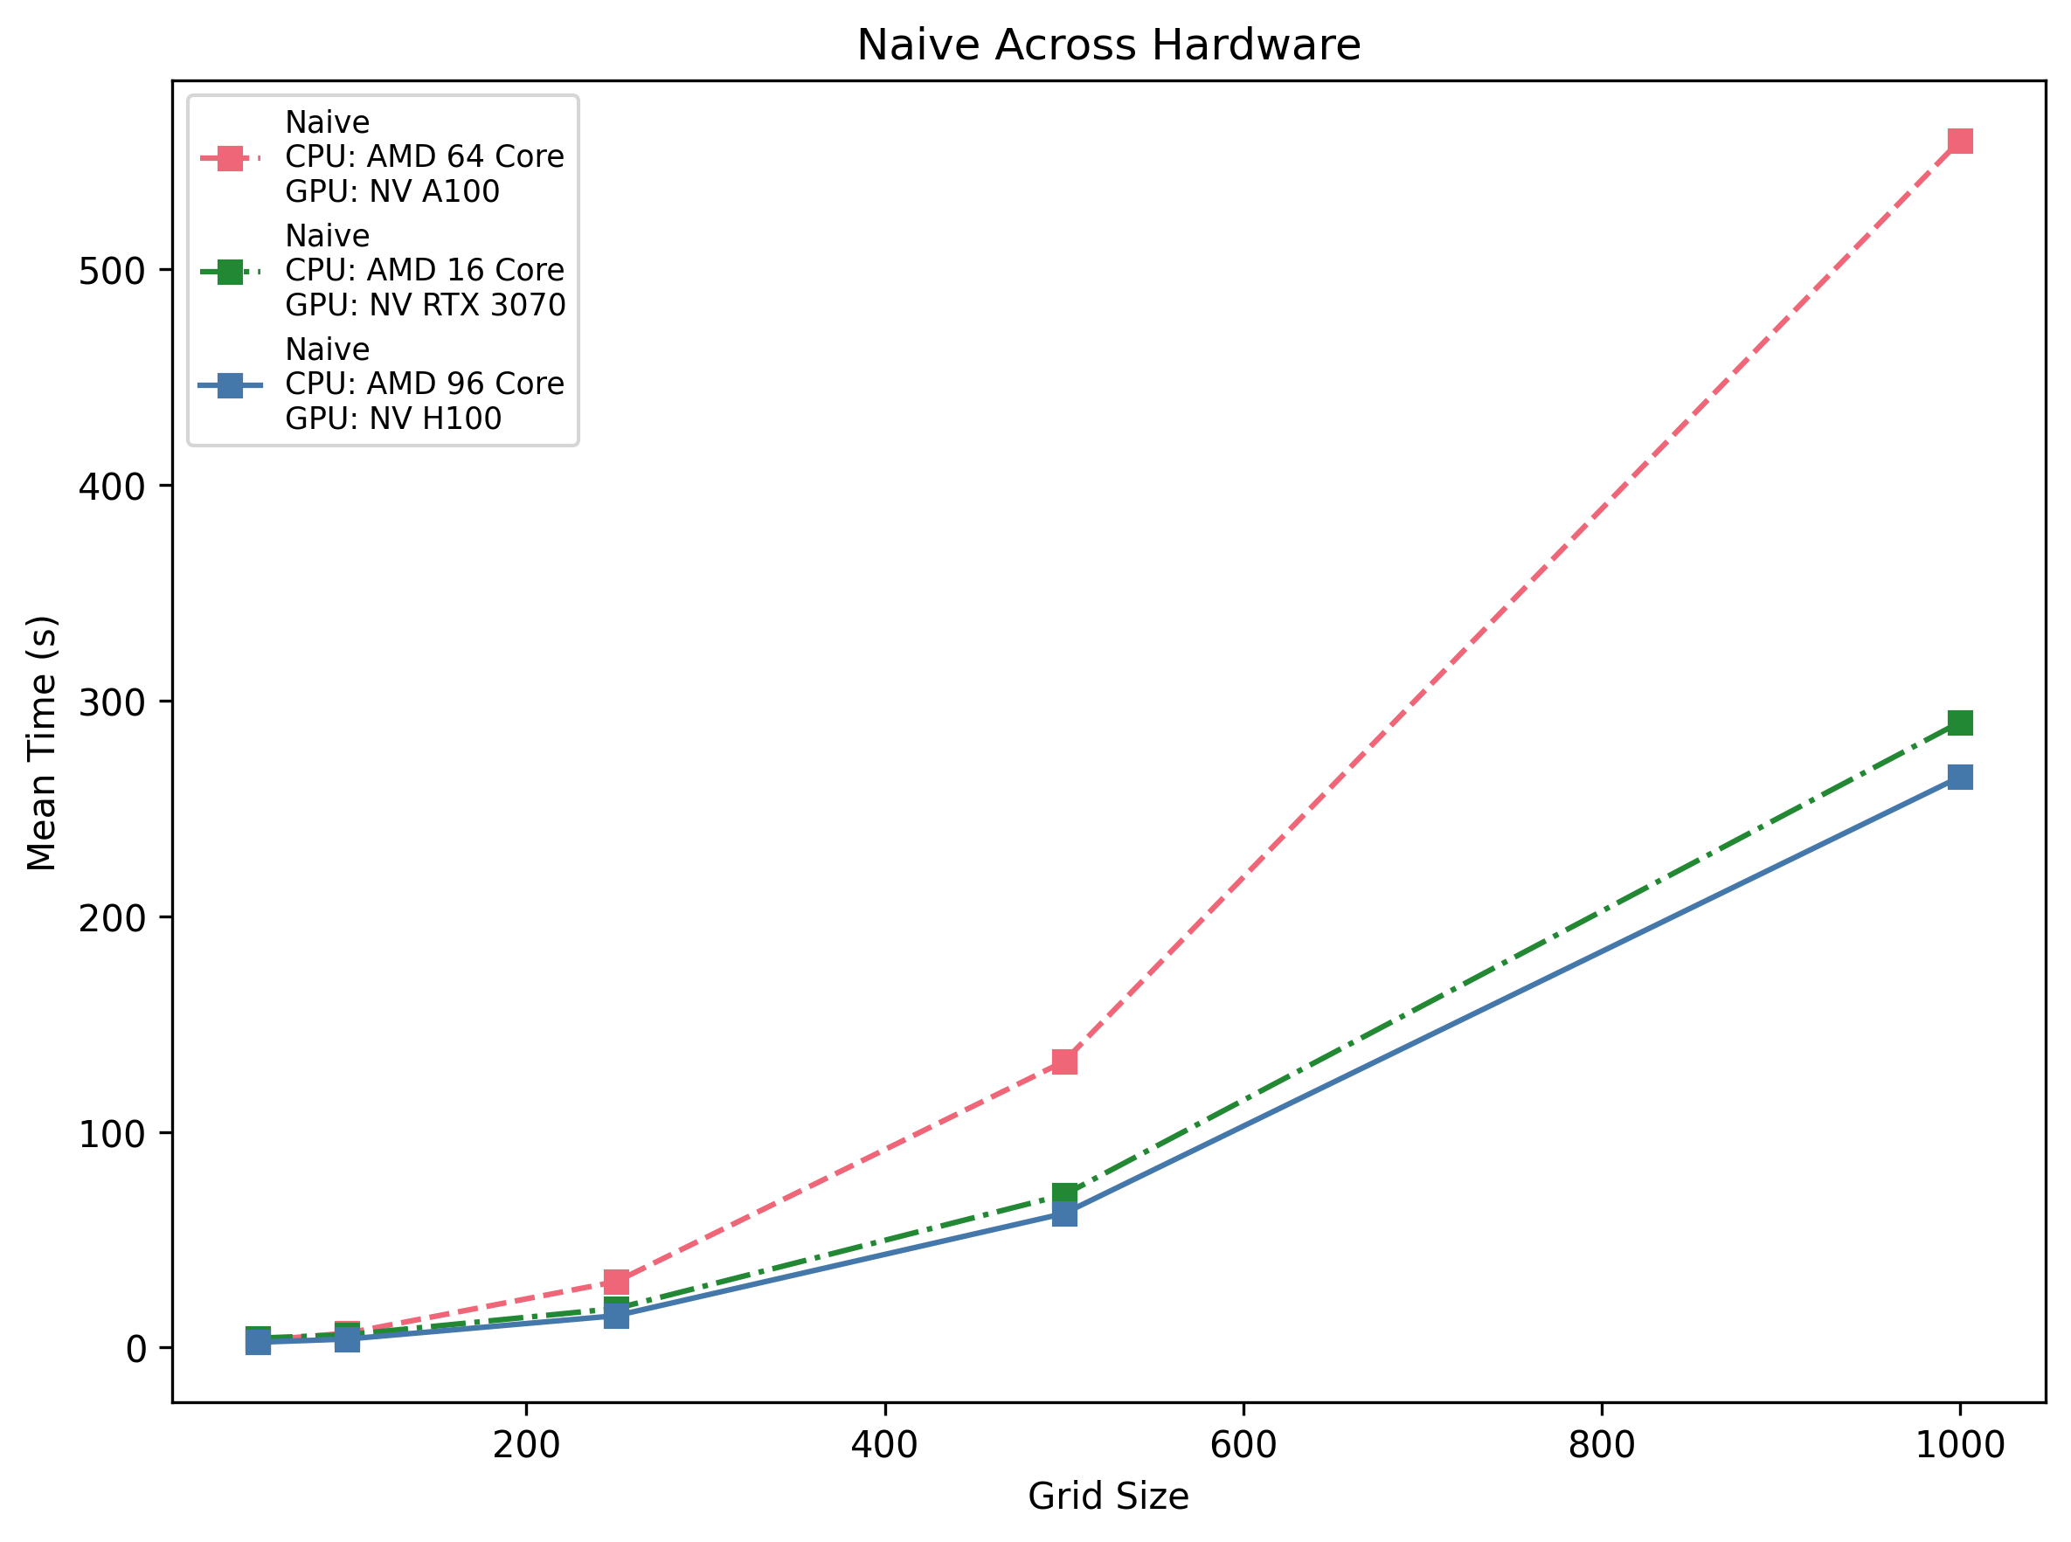
Naïve Implementation Results

Slide 40
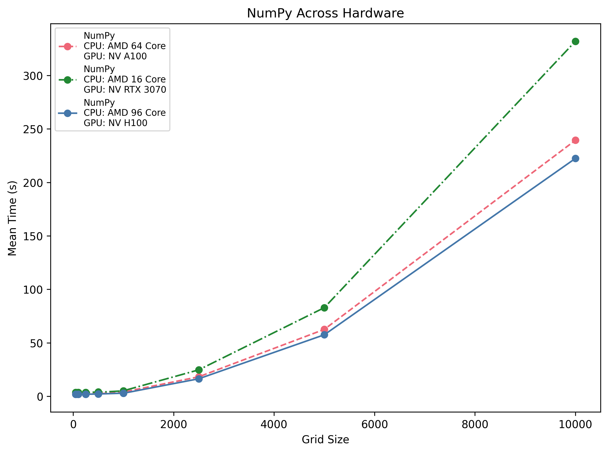
CPU-Vectorised Implementation Results

Slide 41
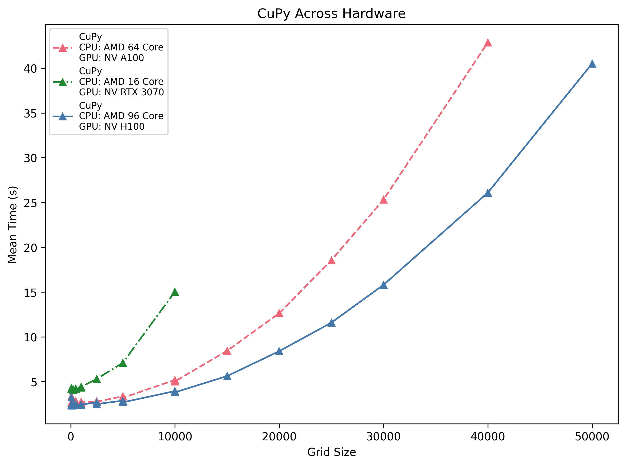
GPU-Vectorised Implementation Results

Slide 42
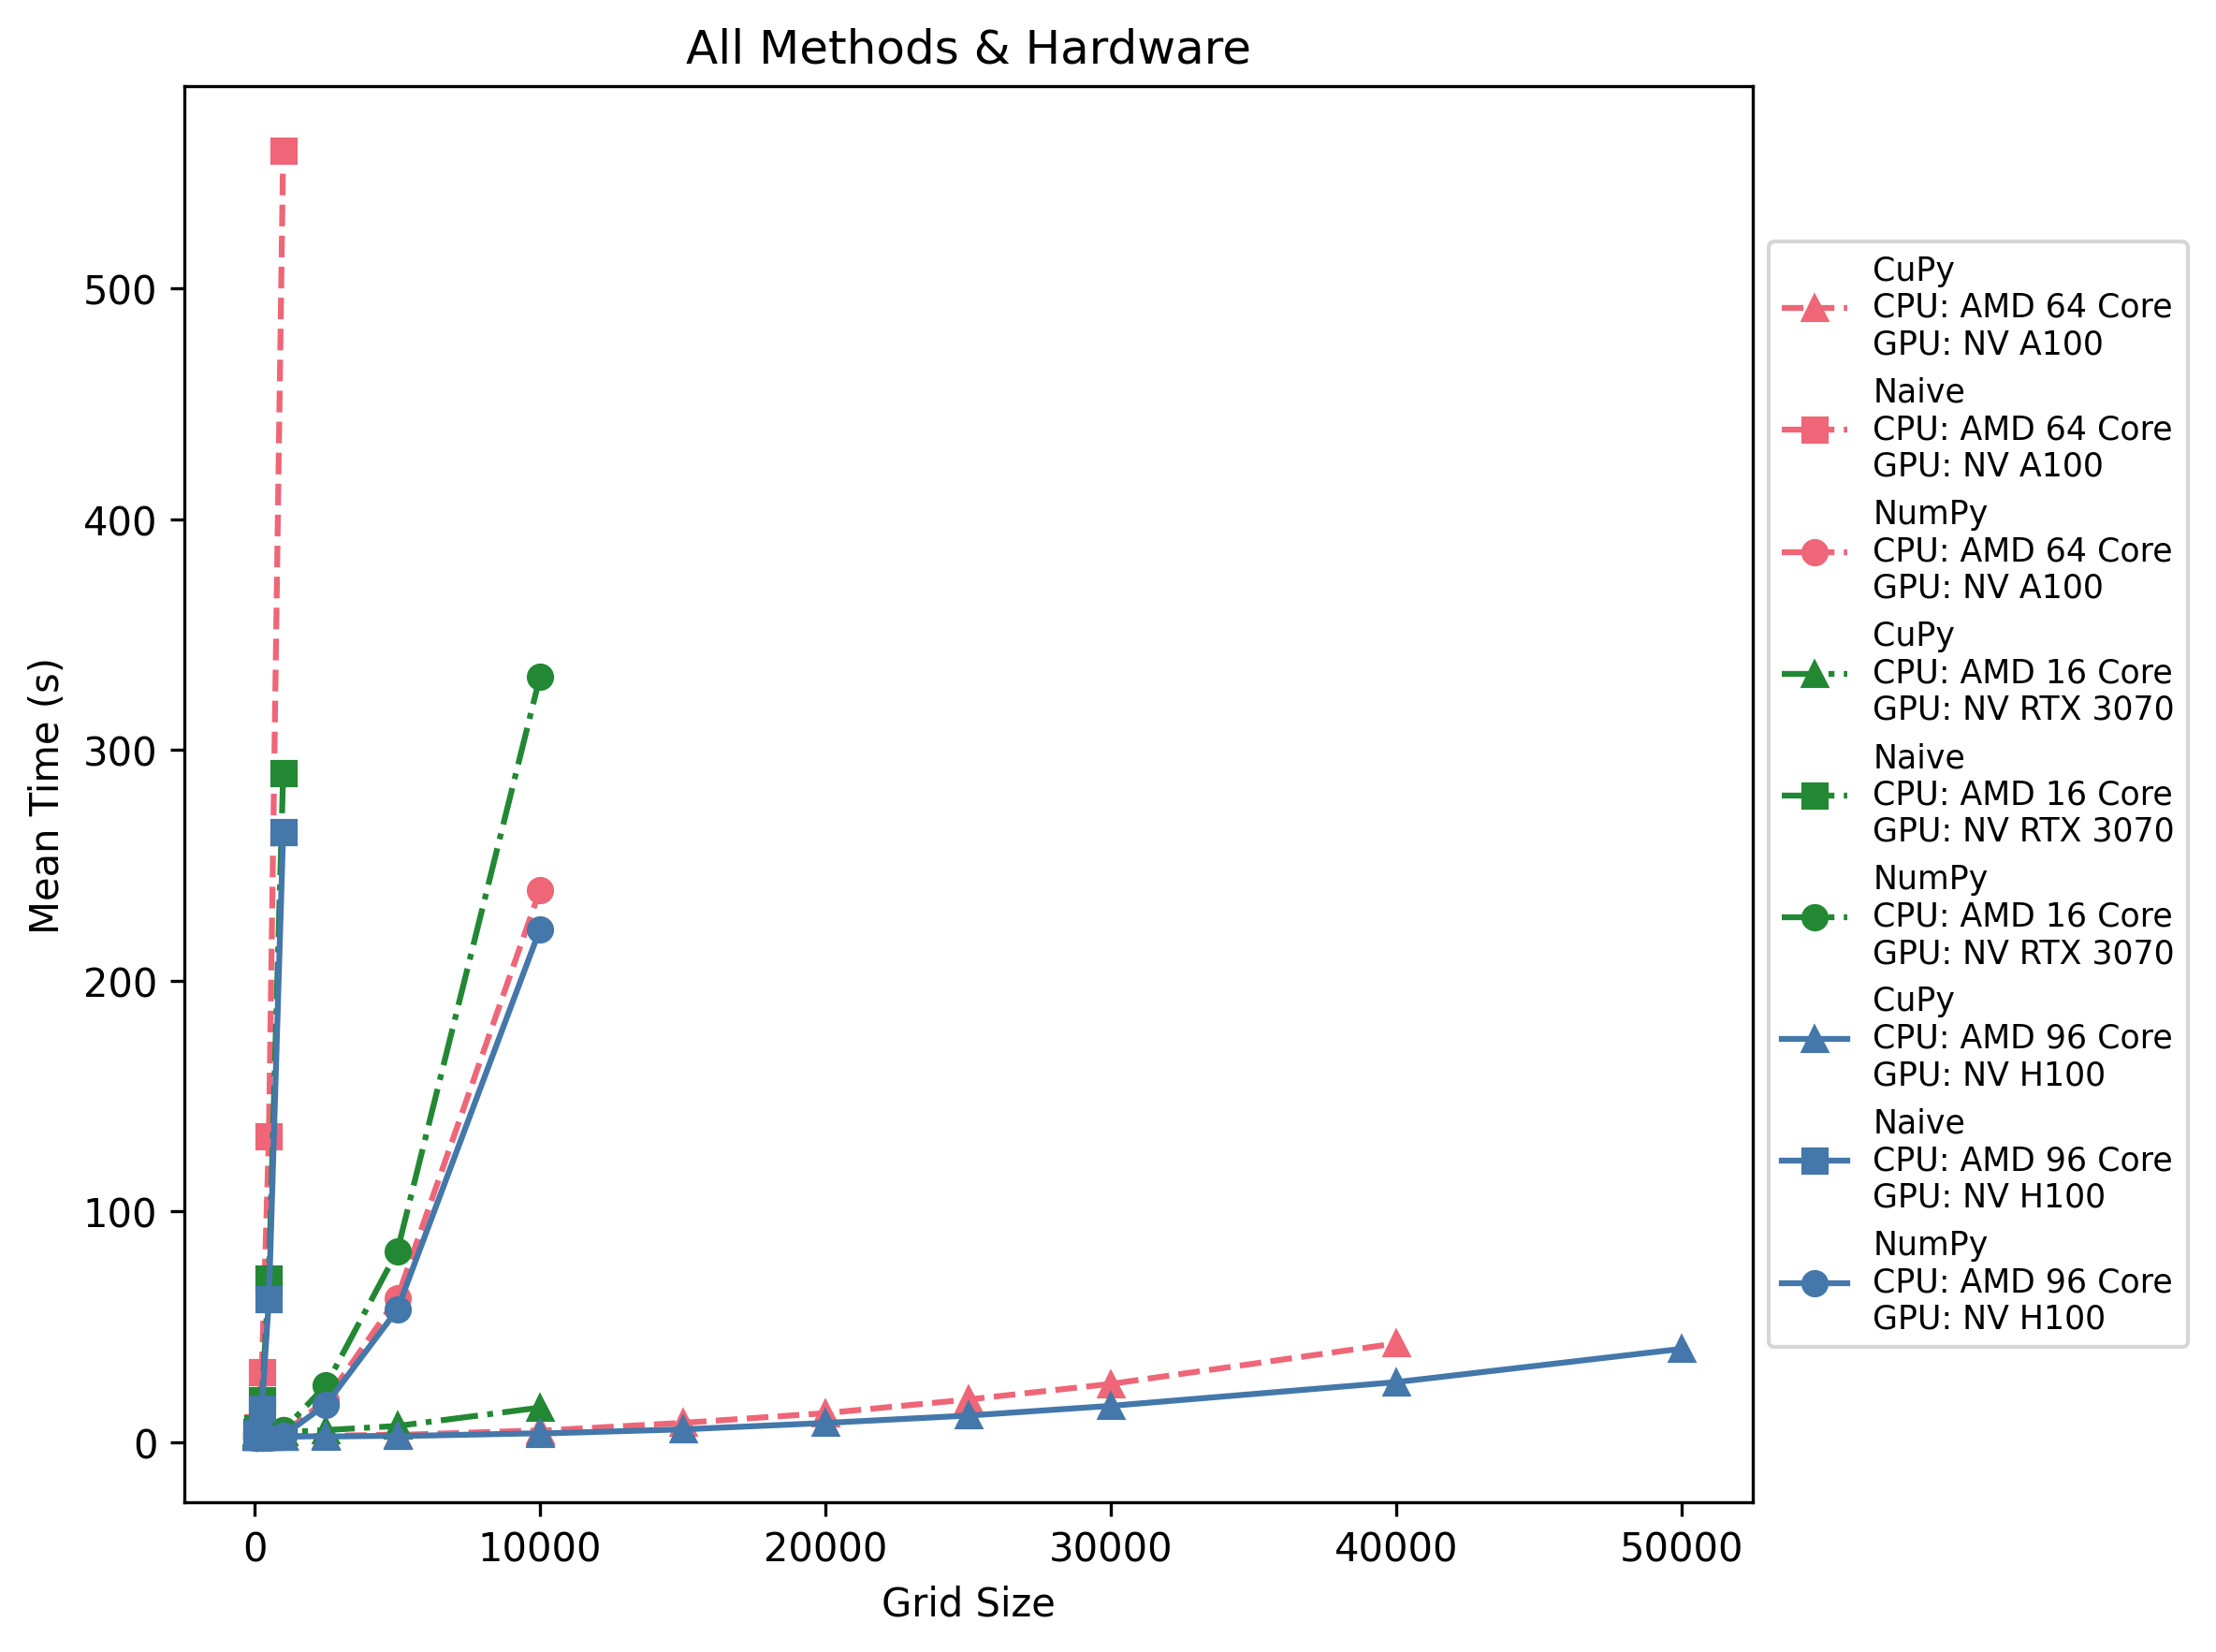
Bringing it together
A full analysis is on the website:
https://uniexeterrse.github.io/GPU_Training/lessons/conways_game_of_life.html
Notes:
Across all three machines, CuPy becomes faster than NumPy at roughly 500–1 k grid size, while naive loops are unusable past ~250. GPU dispatch overhead (~3 s) means tiny grids still favor NumPy or CPU, but anything beyond a few thousand cells per side is best done with CuPy on a modern accelerator.

Slide 43


Which solution to use?
Small Grids (10x10)
Large Grids (500x500)
Notes:
Large grids (e.g. N ≥ 500) or many timesteps: GPU’s parallel throughput outweighs kernel-launch and transfer overhead. Small grids (e.g. 10×10): GPU overhead may dominate, so you may want to stick with NumPy.
Running out of GPU memory: You will also likely hit a point where you run out memory on the GPU that can be a challenge

Slide 44
Exercise: Generate and Visualise Game-of-Life Performance Data
Route 1 | Route 2
Develop and Implement your own Game of Life solution | Profile and explore the existing solution to Game of Life
Notes:
There are a number of different options for what you can do, including developing code yourself, benchmarking and experimenting with different grid sizes.
You can run the different codes with `poetry run <command>`, e.g. running `poetry run python game_of_life.py run_life_naive --size 100 --timesteps 50`
This is also a naïve type of profiling, e.g. just the wall time and the next episode is where we will go into a lot of depth of the different optimisations that can be done and the more nuanced impact of smaller changes.

Slide 45
Profiling and Optimisation

Slide 46
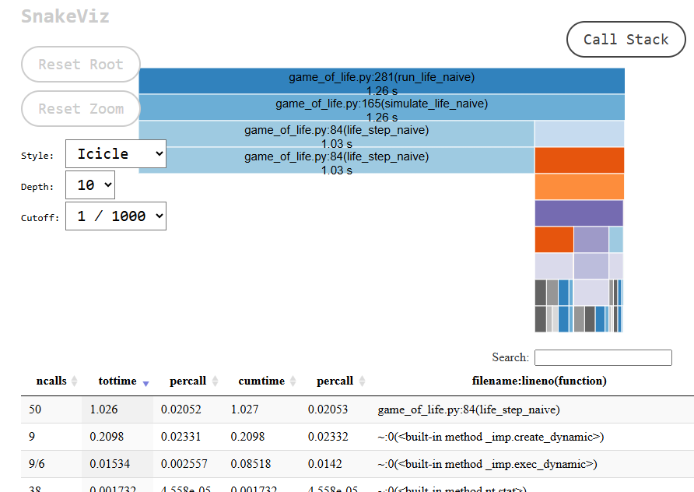
Profiling Code on the CPU
Profile python code with the cProfile from the standard library.
python –m cProfile –o results.stats myscript.py
Can view and format results with standard library pstats module, or other PyPI tools, such as snakeviz:
python –m pip install snakeviz
snakeviz results.stats
Notes:
Provide a demo of how to log into ISCA itself when using VSCode

Slide 47
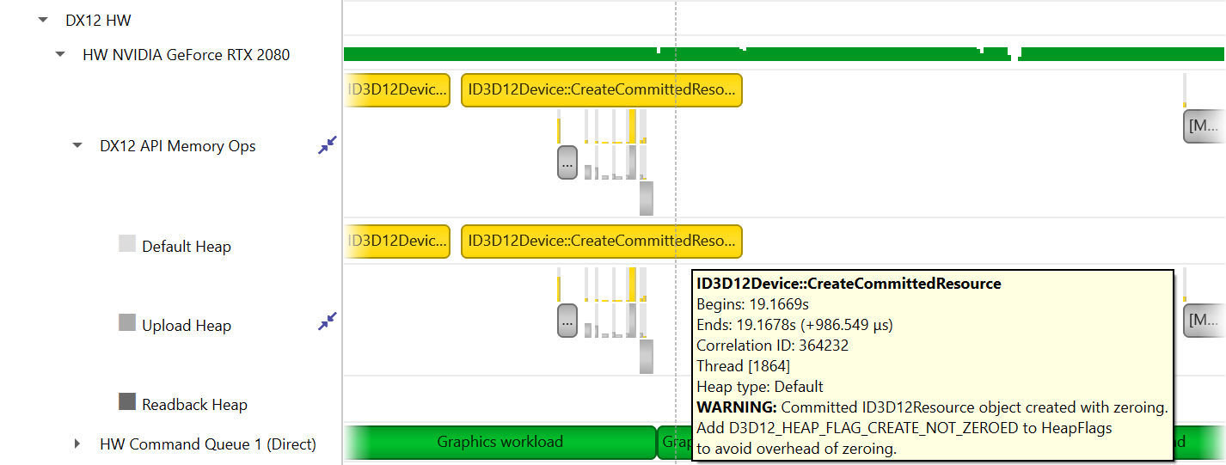
Profiling Code on the GPU
Profile python code with nsys from NVidia:
nsys profile -o profile_report python my_gpu_script.py
Same tool to visualise and analyse the results:
nsys stats profile_report.nsys-rep
(Sample file is included with the course notes under _static/profiling/example_data_file.nsys-rep to play with).
Notes:
Provide a demo of how to log into ISCA itself when using VSCode

Slide 48
Optimising Code - CPU
- Vectorise Operations: We saw this with NumPy; doing things in batches is faster than Python loops.
- Use efficient libraries: NumPy/SciPy/etc. Typically offload meaty computionation to C or another language.
- Optimise algorithms: Sometimes, a better algorithm can speed things up more than any level of optimisation. For example, if you find a certain computation is N^2 in complexity and it's slow, see if you can make it N log N or similar.
- Consider multiprocessing or parallelisation: Use multiple CPU cores (with `multiprocessing` or `joblib` or others) if appropriate.
Notes:
Provide a demo of how to log into ISCA itself when using VSCode

Slide 49
Optimising Code
Minimise data transfers: Once data is on the GPU, try to do as much as possible there.
Kernel fusion / reducing launch overhead: If possible, combining operations into one kernel means the GPU can do it all in one pass. Some libraries or tools do this automatically (for example, CuPy and deep learning frameworks can remove intermediate steps, fusing the operations for efficiency). If not, one can write a custom CUDA kernel to do more work in one go.
Asynchronous overlap: GPUs operate asynchronously relative to the CPU. You can have the CPU queue up work and then do something else (like prepare next batch of data) while GPU is processing. Nsight can show if your CPU and GPU are overlapping or if one is waiting for the other. Ideally, you overlap communication (PCIetransfers) with computation if possible.
Memory access patterns: This is more advanced, but if diving into custom kernel, coalesced memory access (accessing consecutive memory addresses in threads that are next to each other) is important for performance. Uncoalesced or random access can slow down even if arithmetic is small.
Use specialised libraries: For certain tasks, libraries like cuDNN (deep neural nets), cuBLAS (linear algebra),etc., are heavily optimised. Always prefer a library call (e.g., `cp.fft` or `cp.linalg`) over writing your own, if it fits the need, because those are likely tuned for performance.
Notes:
Provide a demo of how to log into ISCA itself when using VSCode

Slide 50
3D Temperature Diffusion

